Slide 1
Ocular US Study
AEMUS Department

Slide 2
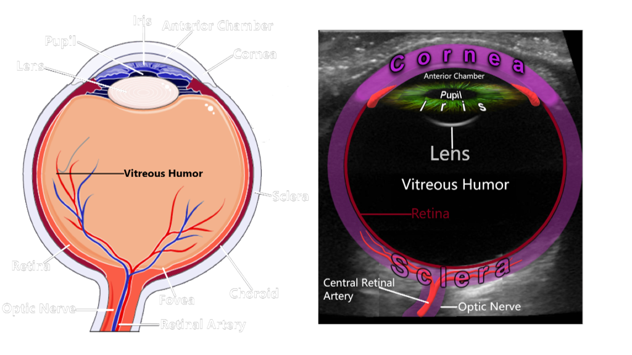
Comparative Investigation of a Water Bath Technique for Ocular Ultrasound Imaging vs. Traditional Gel-Based Technique - A Pilot Study

Slide 3
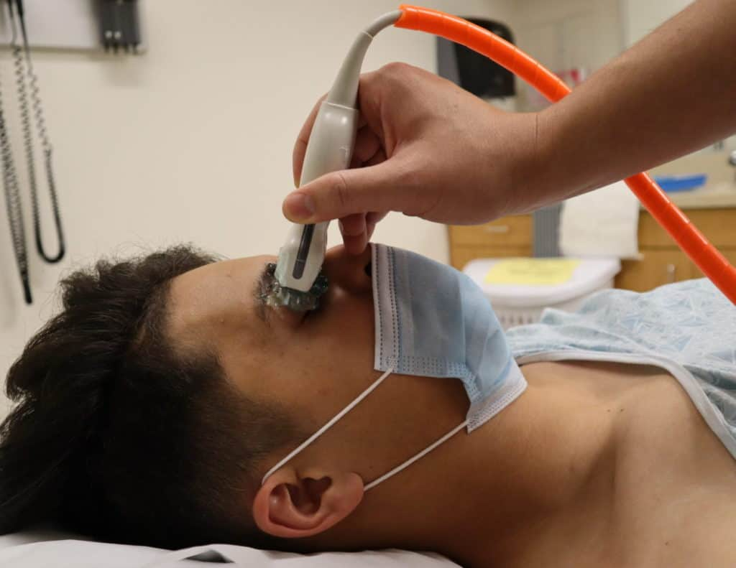
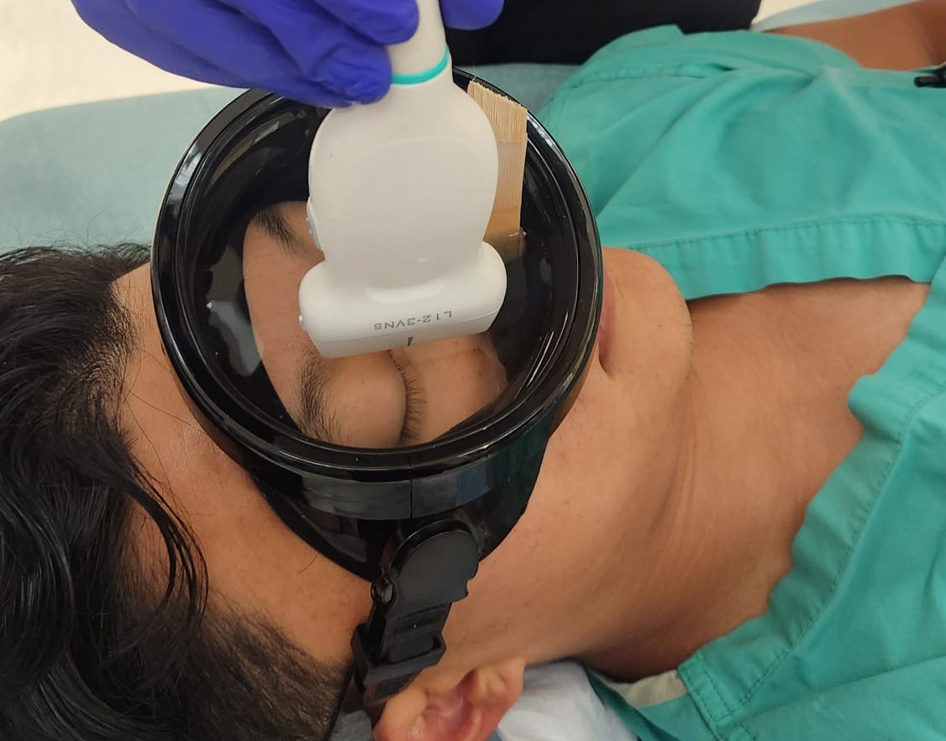
What?
We are comparing traditional ocular ultrasound - i.e. tegaderm, gel then probe versus the idea of a water bath over the eye (such as is used for digit/finger injuries).
VS

Slide 4
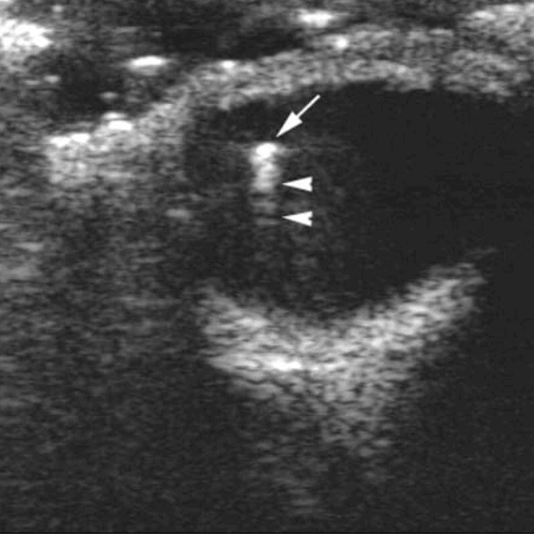
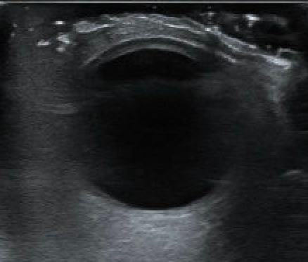
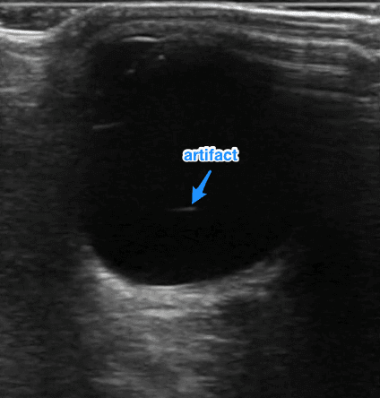
Why?
To determine differences in image acquisition, image quality, and presence of artifacts between the two techniques.

Slide 5

When?
Wednesday, June 18th from 11am - 1pm
We will separate residents in groups of 6 at a time from resident conference

Slide 6
How?
In every group of 6 residents, there will be 3 residents scanning, and 3 residents acting as the eye model.
The scanning residents will perform an ocular ultrasound exam on the model with the traditional gel-based tegaderm technique and then also the novel water bath technique - on BOTH eyes.
A scanning protocol will be utilized.
The residents will then switch places → the scanning resident will become the model, and the eye model resident will become the scanner.

Slide 7
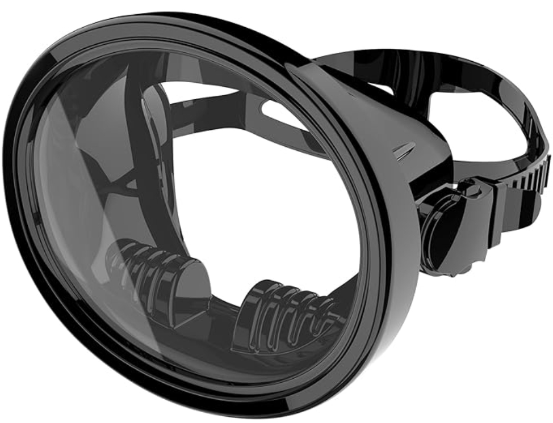
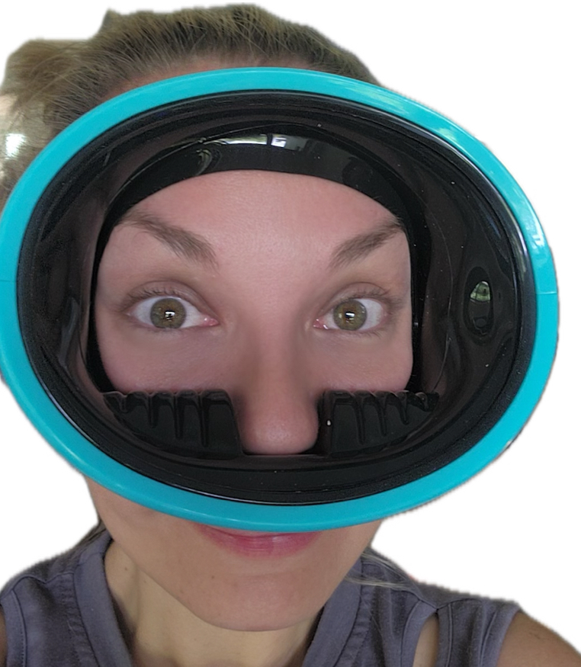
The traditional ocular ultrasound technique should be familiar to you.
However, for the water bath aspect - in order for us to recreate a water bath over the eye, already FDA-approved scuba goggles will be utilized.
The lens has been removed, and a nasal clamp will be placed over your nose to prevent water from being inhaled. You will breath through your mouth for the duration of this technique. Sterile/purified water will be poured in.
(No tegaderm will be applied, eyes will be closed throughout this time)

Slide 8
Each resident will have had both of their eyes scanned, with both techniques. And each resident will also have performed an ocular ultrasound scan on another resident’s eyes with both techniques.
→ Please read the consent form provided which goes over the overall procedure, risks and discomforts.
→ Ensure you do not meet any of the exclusion criteria prior to signing (i.e. recent eye trauma, allergies to adhesive/gel, active eye infection)

Slide 9
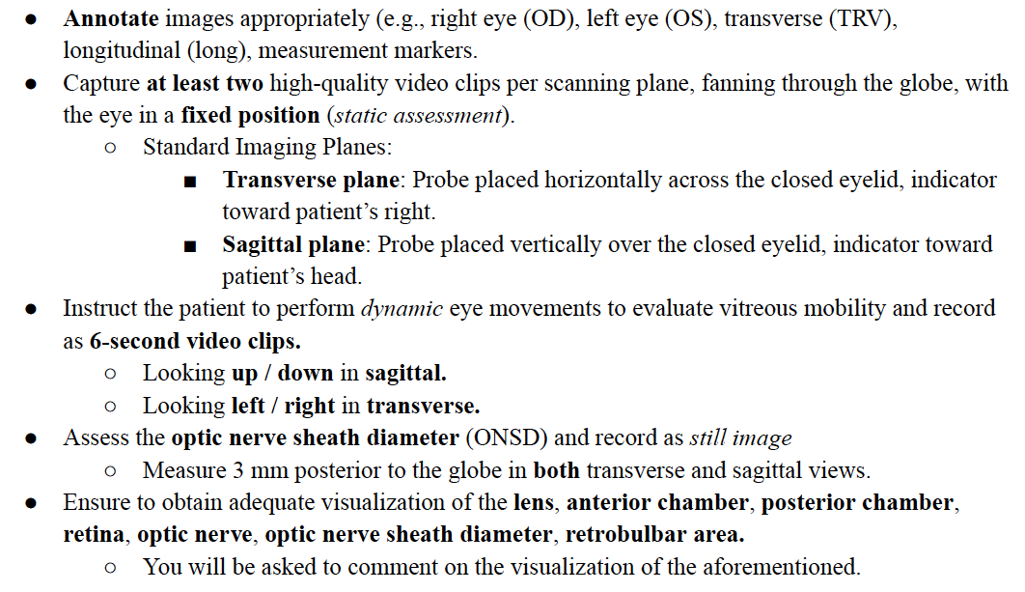
Protocol

Slide 10
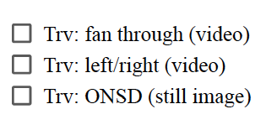
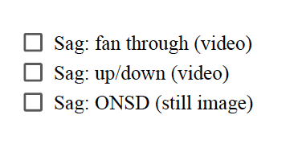
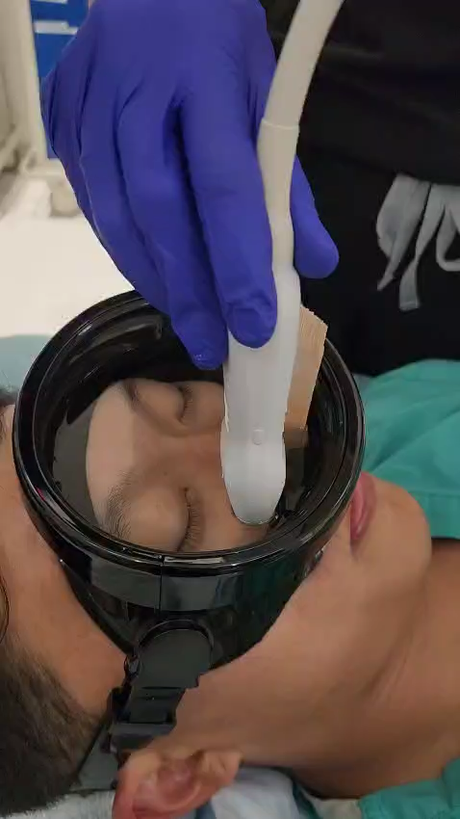
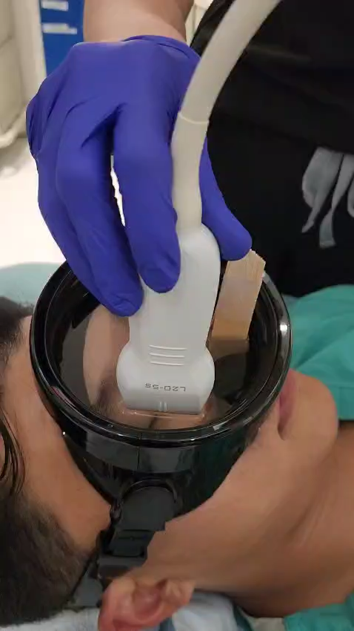
Protocol
Fanning/sliding through in transverse
Fanning/sliding through in sagittal

Slide 11
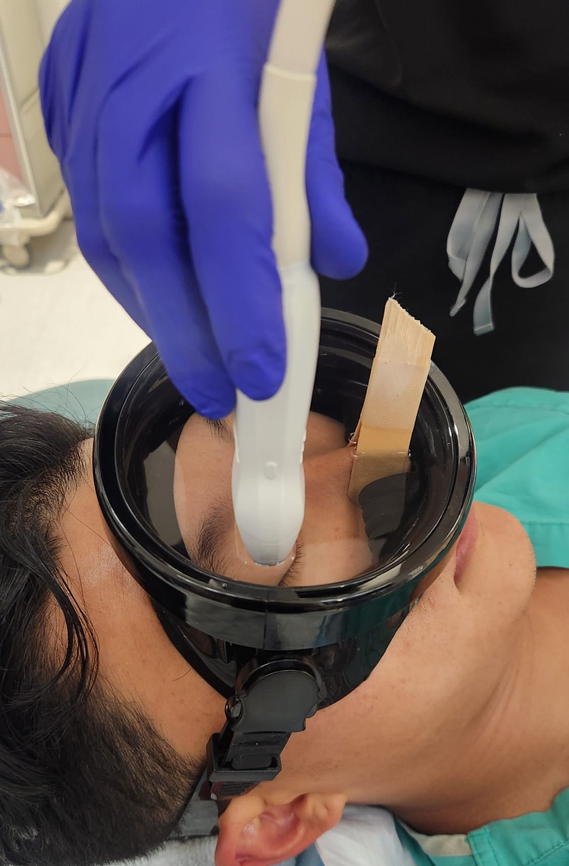
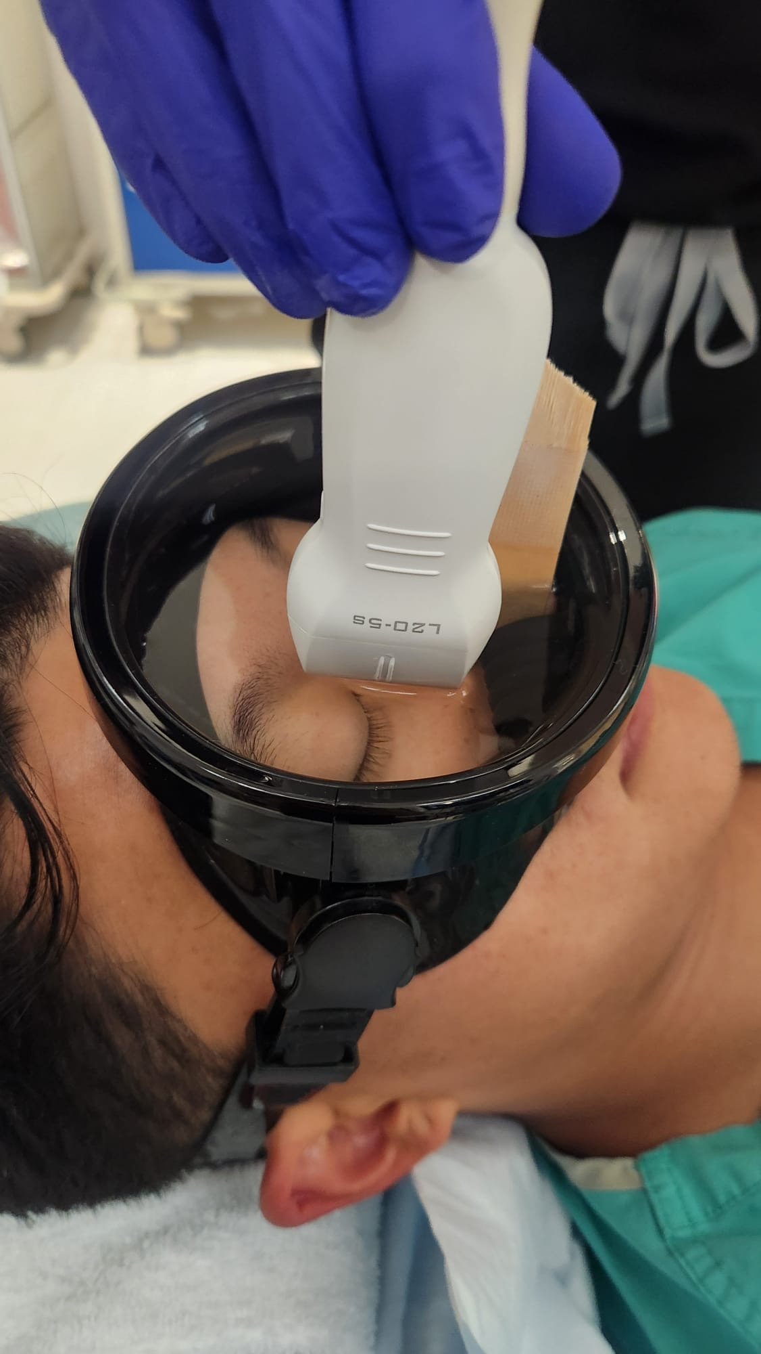
Protocol
Hold probe still, in transverse, ask patient to move eyes left and right
Hold probe still, in sagittal, ask patient to move eyes up and down

Slide 12
Protocol
Hold probe still, in transverse, freeze and measure ONSD
Hold probe still, in sagittal, freese and measure ONSD

Slide 13
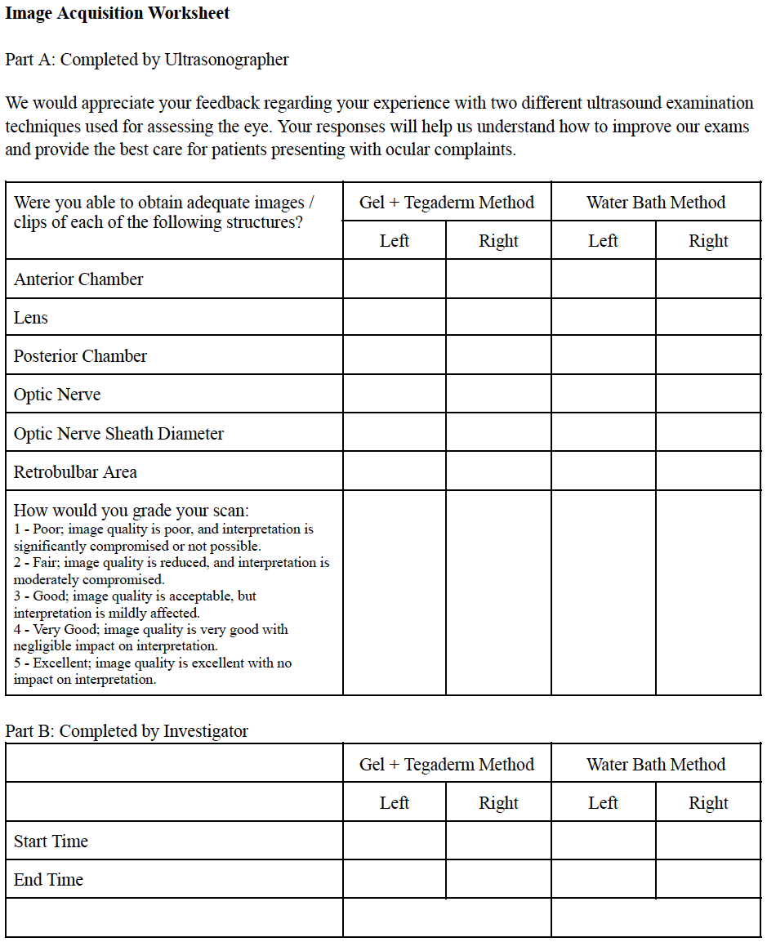
Post-Study Survey

Slide 14
Thank you!
We appreciate you volunteering to help us in our efforts to complete this study.
Should you have any questions or concerns, please contact us directly!
Andreea Popa, MD → 985-710-1828
Danielle Glaze, DO → 850-748-0588

